Slide 1

GOBIND ELECTRICAL CORPORATION
ADDRESS :- GOBIND ELECTRICAL CORPORATION
PLOT NO.371,IND-AREA,PHASE-2, CHANDIGARH 160002
PHONE NO. 98154-88119,99151-88119
EMAIL : gobind.ec@gmail.com, Web Site : www.panelbaba.com

Slide 2
ABOUT GOBIND ELECTRICAL CORPORATION :-
We Deal in custom built low voltage & Medium Voltage panels, Switch gears, Motor Starter’s & Automation Panels in Chandigarh region.
We have a complete range of Panels i.e. PCC,MCC,APFC,DB,PLC,VFD,SOFT STARTER,AMF PANEL,DG SYNC.
We also deal in Electrical & Automation instruments, Gensets, Servo Stabilizer, Transformers & other several electrical Equipment’s.
INTRODUCTION :-
We offer customized electrical solutions for all industries. Thanks to our many years of experience, we have unique knowledge about different industries and operators’ specific requirements. Whether it is for small and medium manufacturing industries or large oil & energy suppliers: We offer custom solutions for all industries. Our focus is on highly efficient, environmentally safe solutions and services.
OUR VISION:-
GEC Shall be the most reliable & leading organization delivering world class products & solution’s to both local & global markets.
OUR MOTTO:-O
Our agenda is 100% Client satisfaction with focus on no compromise in quality and timely delivery of product as per our commitment.
Long term relationship with Government and Private Institutions for as long as 30 years with no complains whatsoever speaks for our work efficiency.

Slide 3
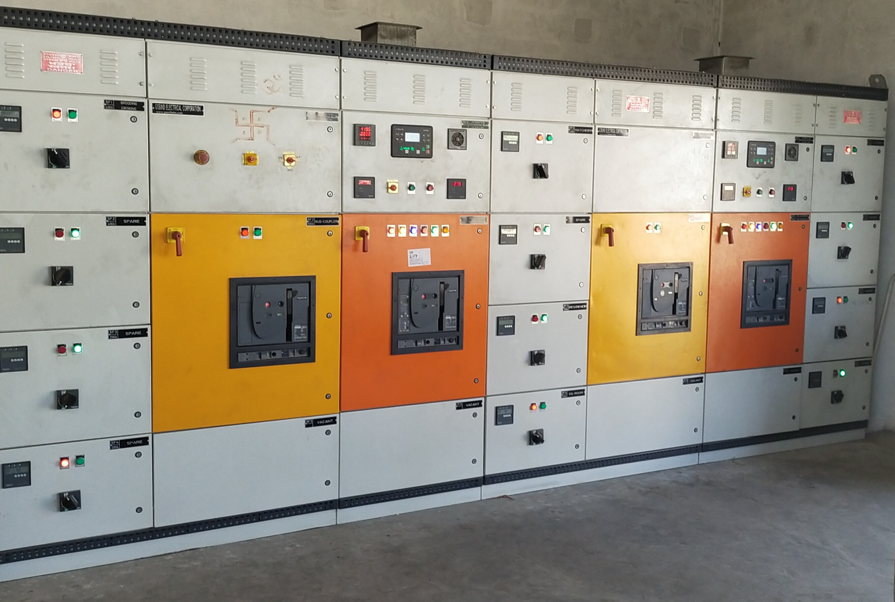
OUR PRODUCT RANGE
PCC PANEL
MCC PANEL
APFC PANEL
AMF PANEL
DG SYNCHRONIZATION PANEL
DG LOAD MANAGEMENT
FIRE FIGHTING PANEL
CHANGEOVER PANEL
PLC & AUTOMATION PANEL
VFD/SOFTSTARTER PANEL
HVAC PANEL
BUILDING AUTOMATION PANEL
SOLAR ACDB/DCDB
OUTDOOR PANELS
POWER DISTRIBUTION PANEL
SERVO VOLTAGE STABILIZER
TRANSFORMER
DEISEL GENSETS

Slide 4
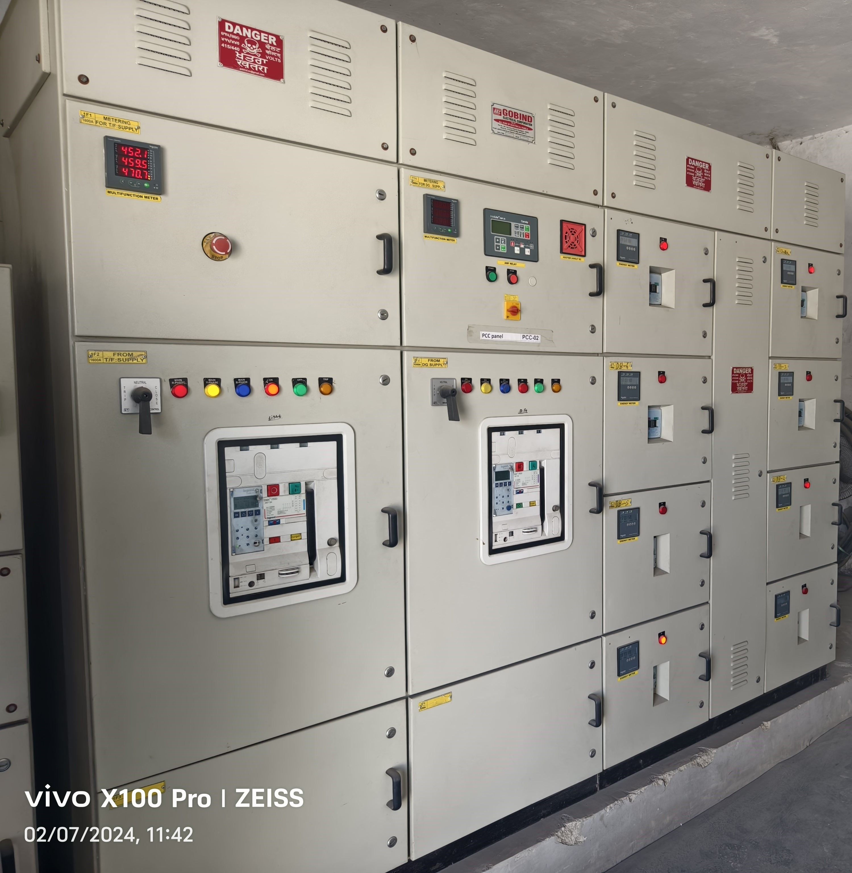

Slide 5
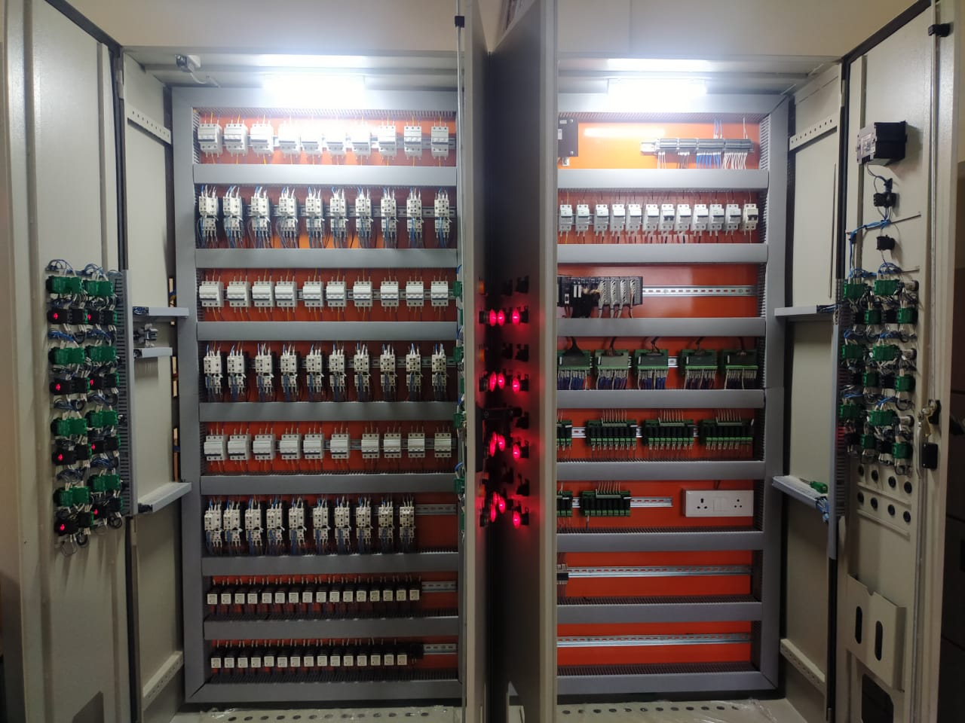
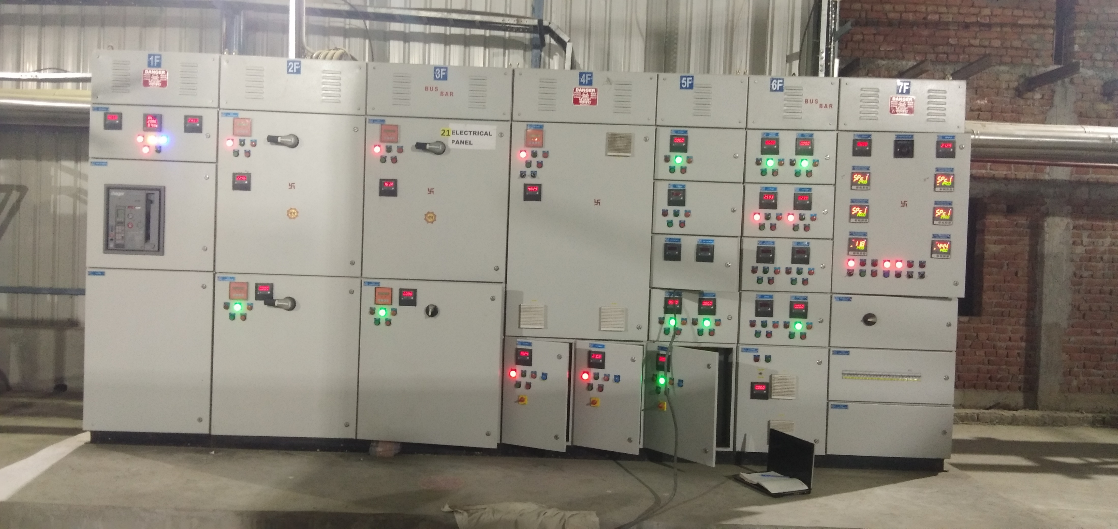
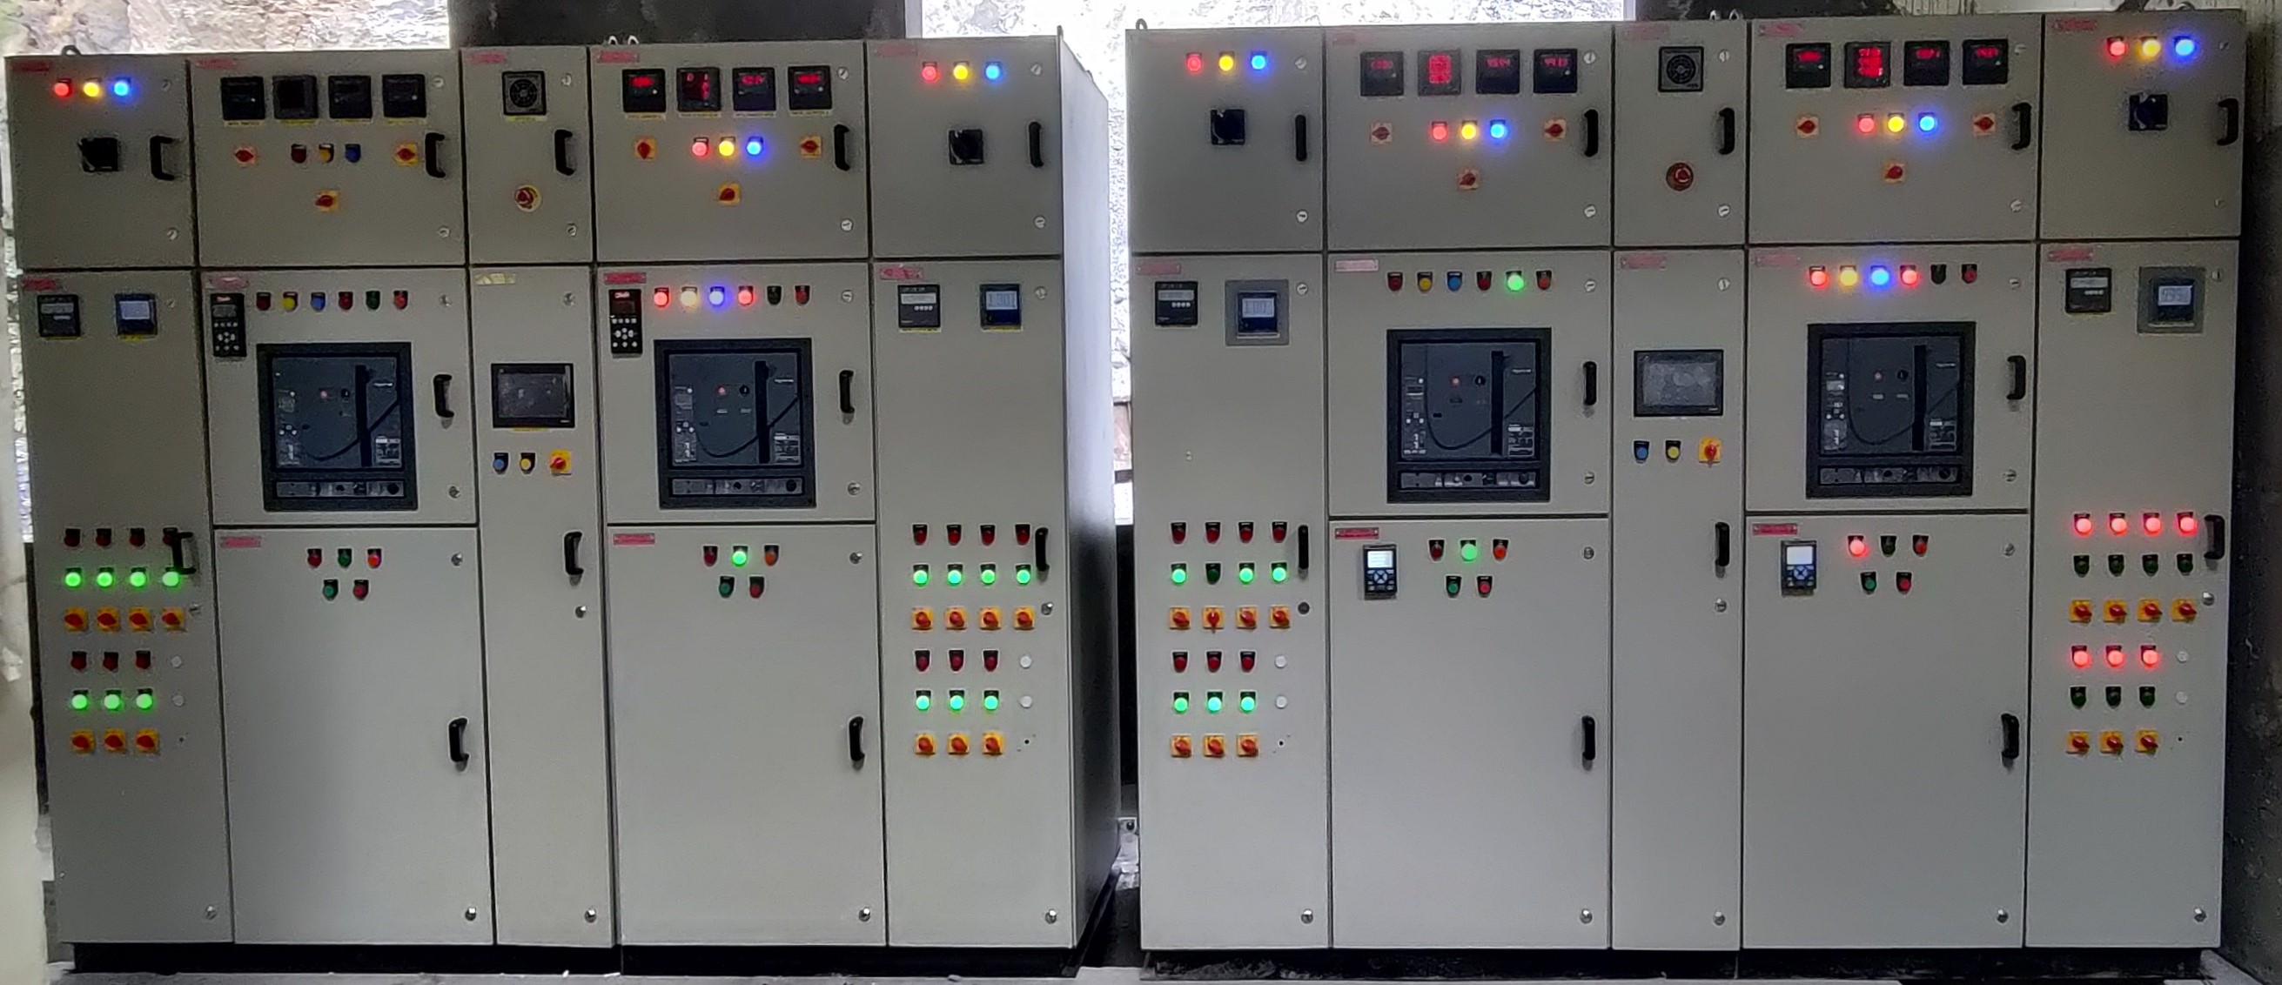
MCC PANEL’S

Slide 6
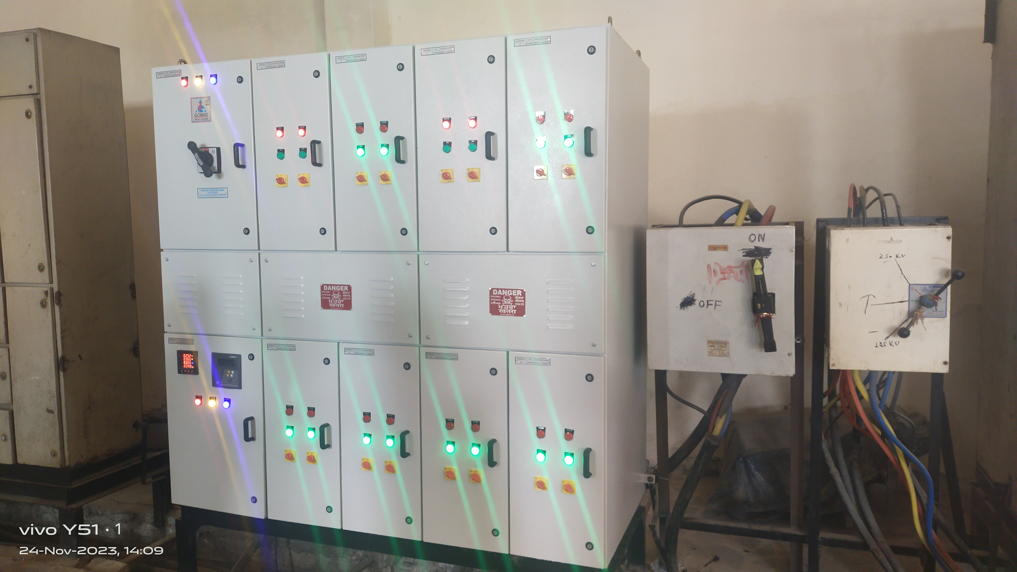
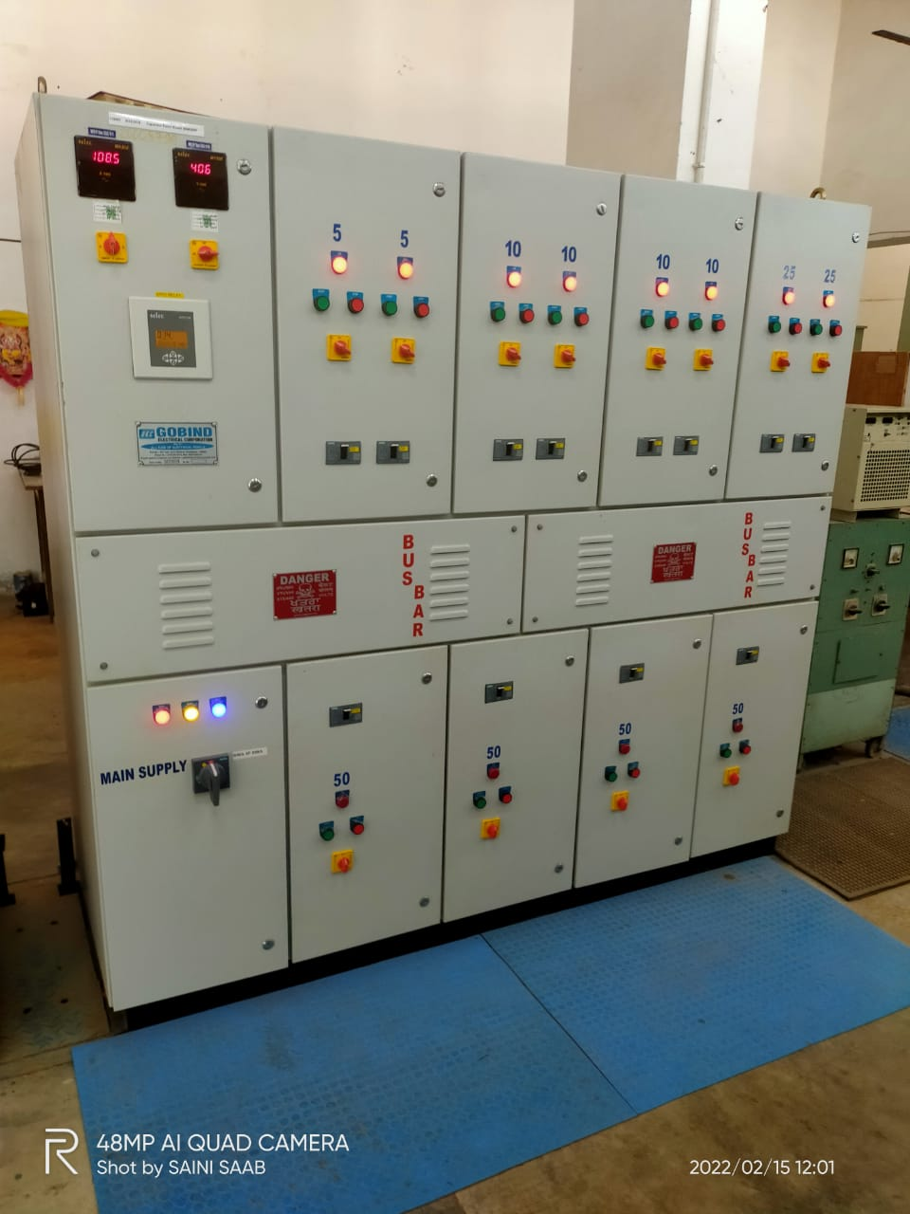
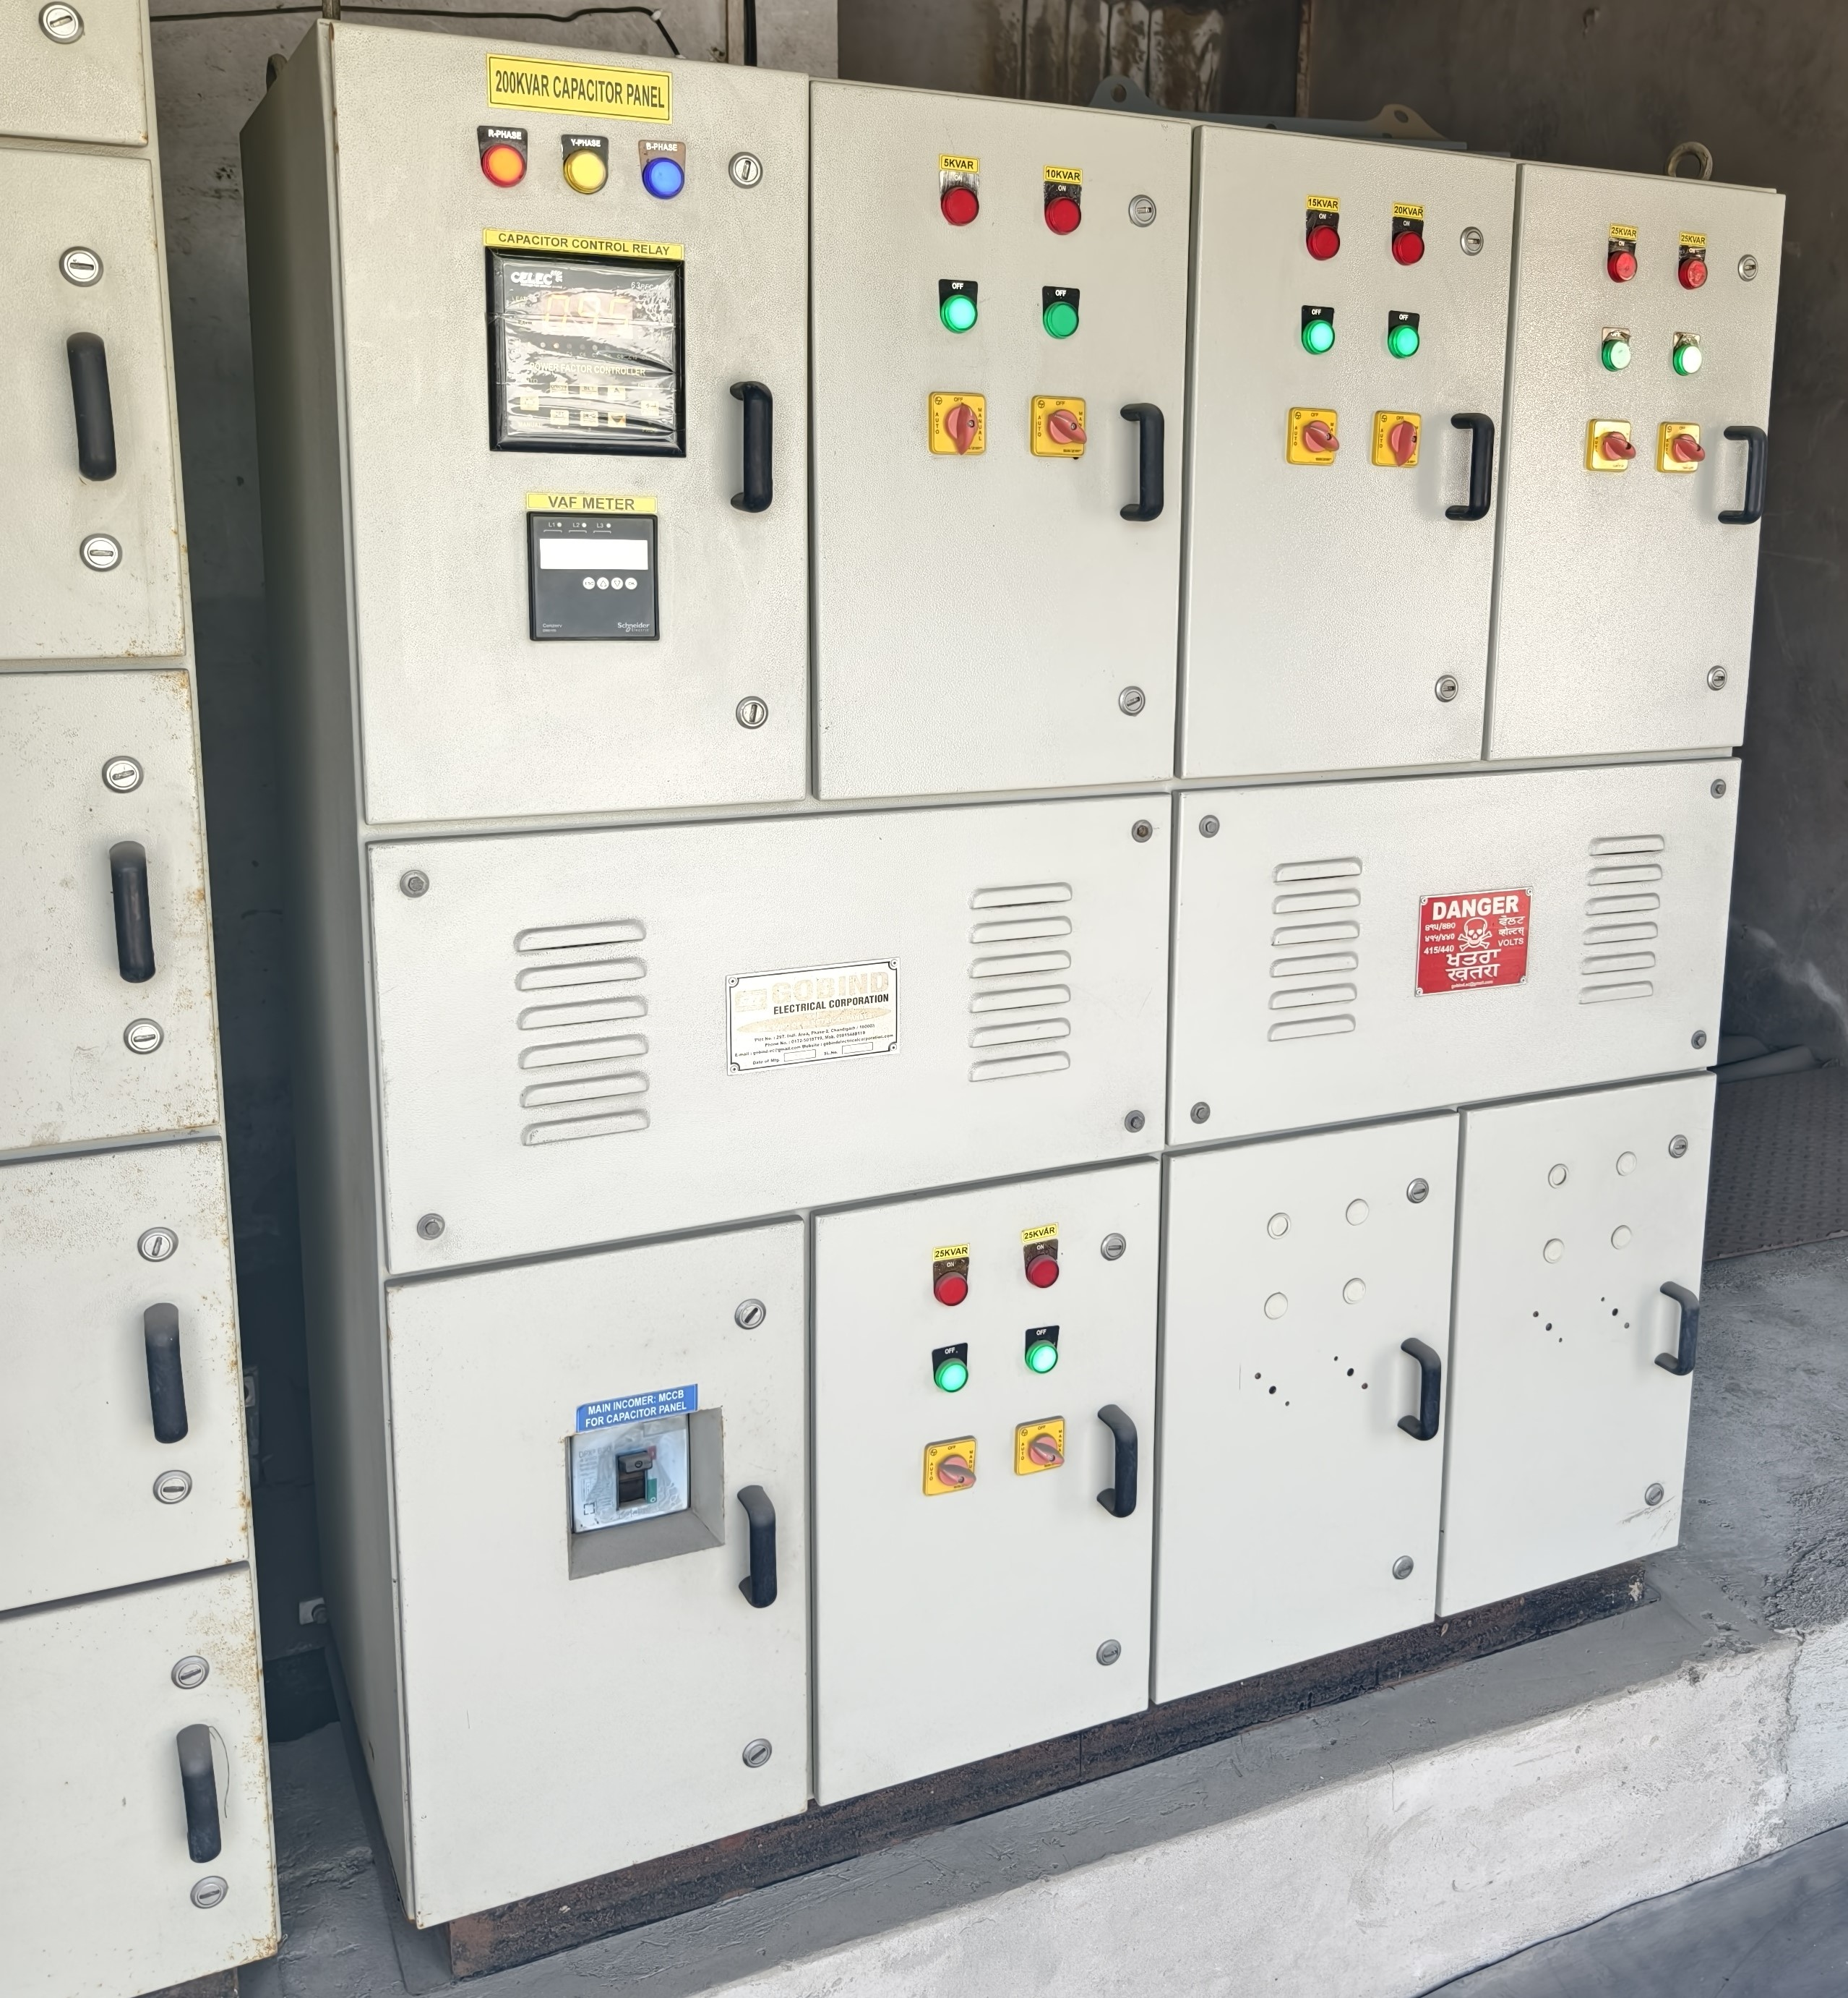
CAPACITOR BANK PANEL

Slide 7
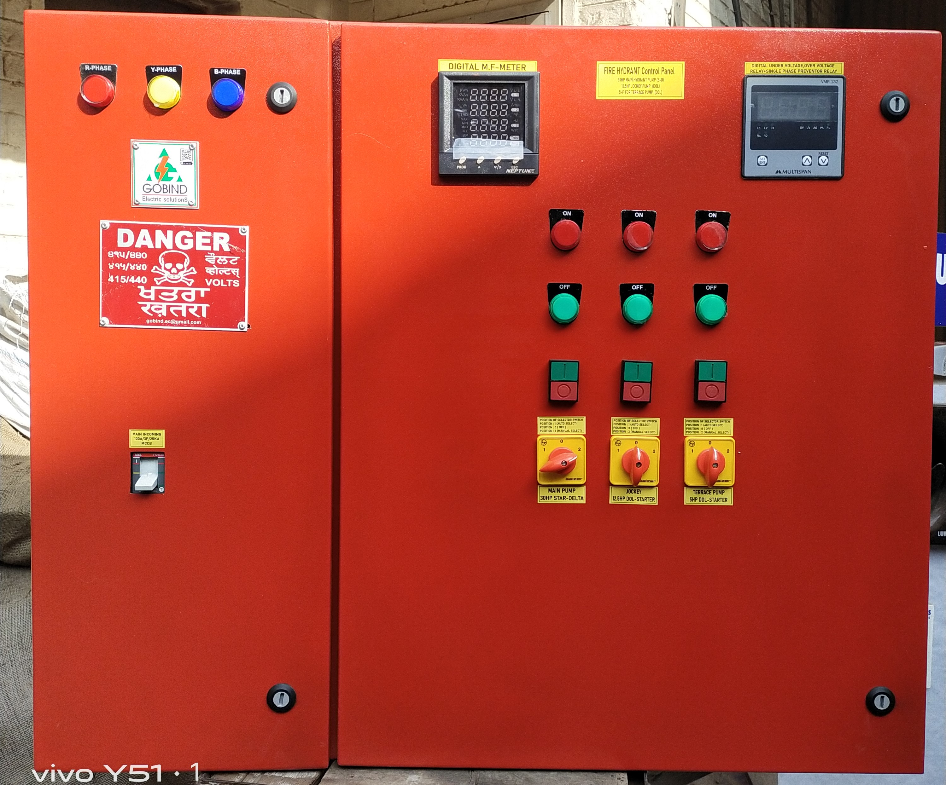
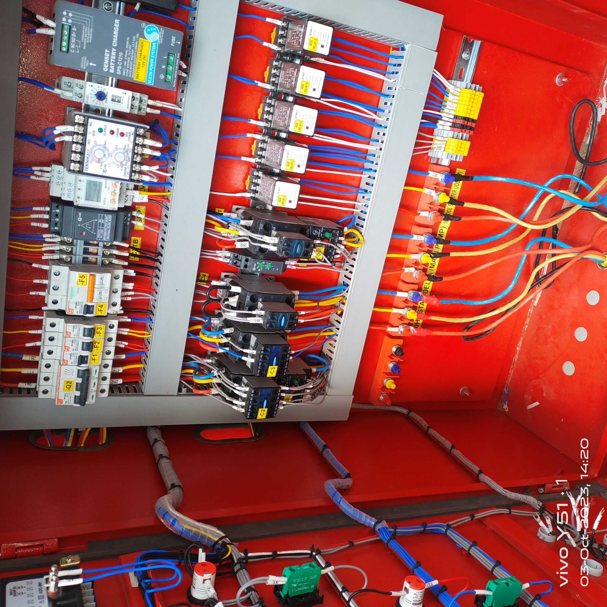
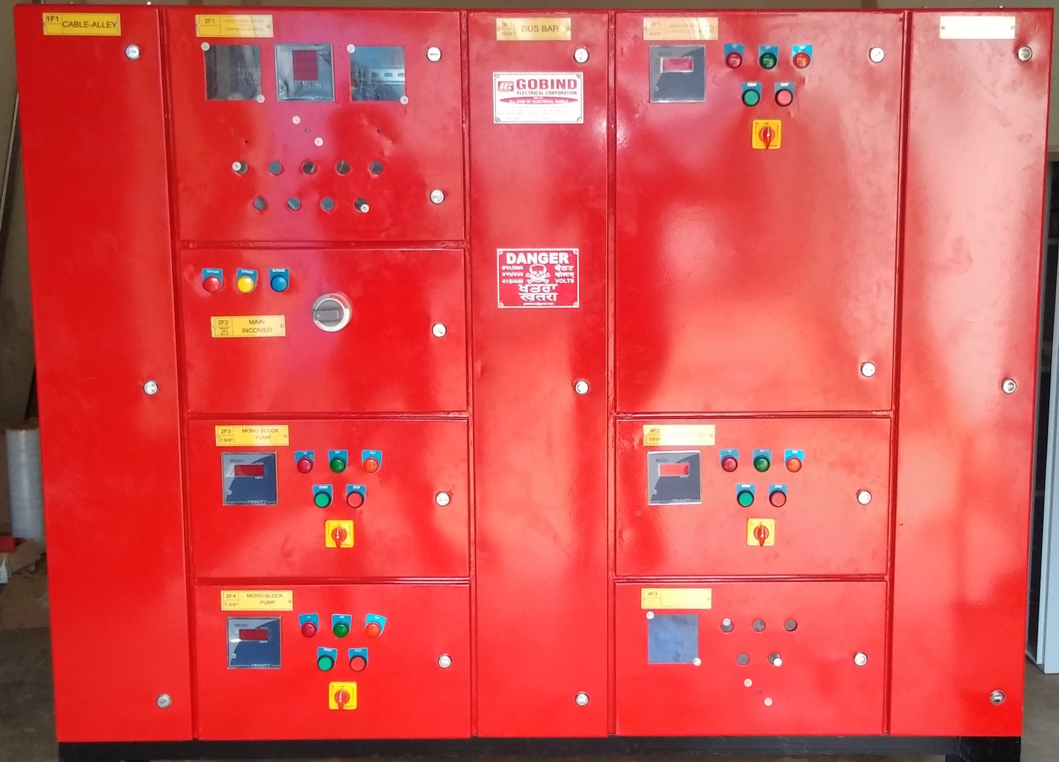
FIRE FIGHTING PANEL

Slide 8
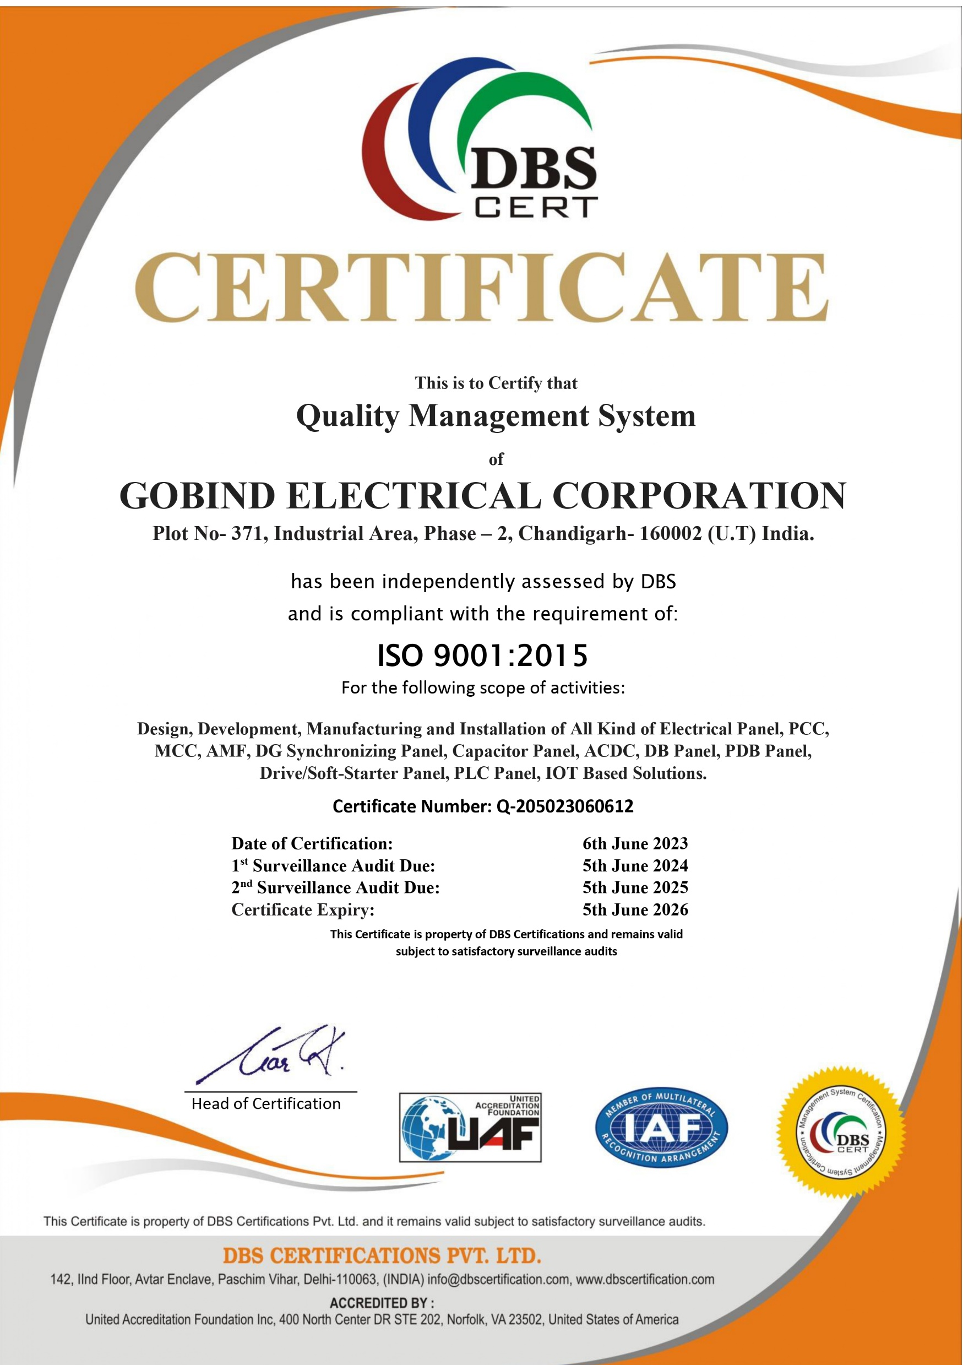

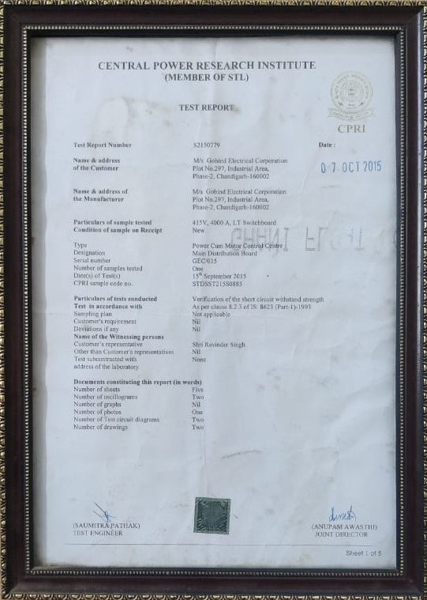
CERTIFICATIONS

Slide 9
OUR PRESTIGIOUS CLIENTS
PHARMA
TEXTILE
HOTEL
INDUSTRY
MERIDIAN MEDICARE LTD
PERENNIAL MEDICARE
LENUS LIFECARE LTD
SWISS GARNIER
SUN PHARMA
SCOTT EDIL
LOREAL
CIPLA
AARTI SPINING MILL
DEEPAK SPINING MILL
VARDHMAN TEXTILE
TRIDENT GROUP
ELYSIUM SHIMLA
GRAND SHIMLA
GRAND OBERIA
CASTLE BANQUETS
PLATINUM RESORTS
SHIMLA HILLS INT.
RETREAT RESORTS
BAIKUNTH RESORTS
SWAGAT RESTRAUNTS
SOCIAL
VEELINE INDUSTRIES
SARASWATI GROUPS
GREEN & ARTS
AMSON ELECTRONICS
VISHWAKARMA ENGG.
SAMRATH AUTOMOTIVE

